Slide 1
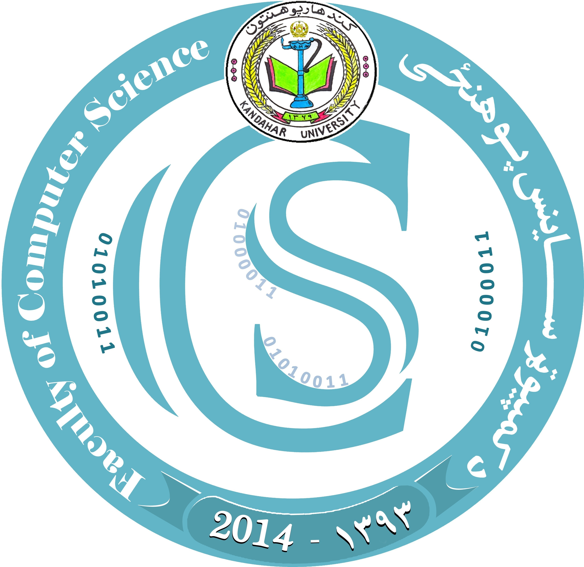

KANDAHAR UNIVERSITY Faculty of Computer Science 2 st year, 3st semester
Photo healing in python
Group members :
Munir ahmad
Abdul hadi
Hayatullah
Salim
Ishaq

Slide 2
﷽

Slide 3
photo healing in python
Photo healing in python refers to the process of improving and restoring damaged or imperfect images using various image processing techniques and algorithms .
The aim is to enhance the visual appearance of the photo by removing any unwanted or distracting elements and improving the overall quality .

Slide 4
Count….
The process of photo healing in python typically involves the following steps.
Image loading .
Image processing .
Spot and scratch removal.

Slide 5
Image loading
The first steps is to load the damaged or imperfect image into the python environment.
This can be done using libraries like openCV or PIL(python imaging library)

Slide 6
Image preprocessing
Before applying healing techniques , it is important to preprocessing the image .
This may involve resizing , cropping , and adjusting the brightness , contrast, and color balance to make the image more suitable for healing .

Slide 7
Spot and scratch removal
One of the main tasks in photo healing is to remove spots ,
Scratches and other unwanted imperfections from the image this can be achieved by applying various image filtering techniques like median filtering Gaussian smoothing , or using more advanced algorithms like inpainting.

Slide 8

Thank you from your attention !

